Slide 1
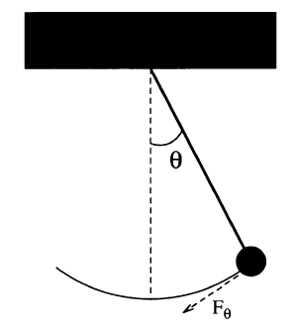
Modelling a Simple Pendulum
Gravity is a restoring force
$$F_{θ}=−mg\sin{θ}$$
$$ml\frac{d^{2}θ}{dt^{2}}=−mg\sin{θ}$$
$$l$$
$$\frac{d^{2}θ}{dt^{2}}=−\frac{g}{l}\sin{θ}$$
$$s=0$$
$$s=lθ$$
$$F=ma$$
$$\frac{dω}{dt}=−\frac{g}{l}\sin{θ}$$
We can break the 2nd order ODE into two linked 1st order ODEs
$$\frac{d^{2}s}{dt^{2}}=l\frac{d^{2}θ}{dt^{2}}$$
$$F=m\frac{d^{2}s}{dt^{2}}$$
$$\frac{dθ}{dt}=ω$$
$$F_{θ}=ml\frac{d^{2}θ}{dt^{2}}$$

Slide 2
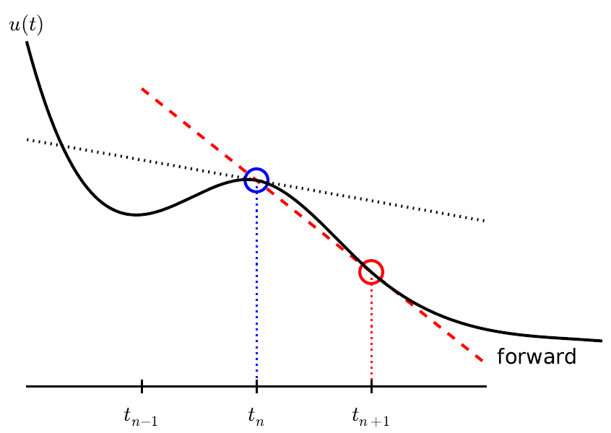

Modelling a Simple Pendulum
$$\frac{dω}{dt}=−\frac{g}{l}θ$$
$$ω_{i+1}=ω_{i}−\frac{g}{l}θ_{i}Δt$$
$$l$$
$$\frac{dθ}{dt}=ω$$
$$θ_{i+1}=θ_{i}+ω_{i}Δt$$
$$s=0$$
This is Euler’s Method

Slide 3

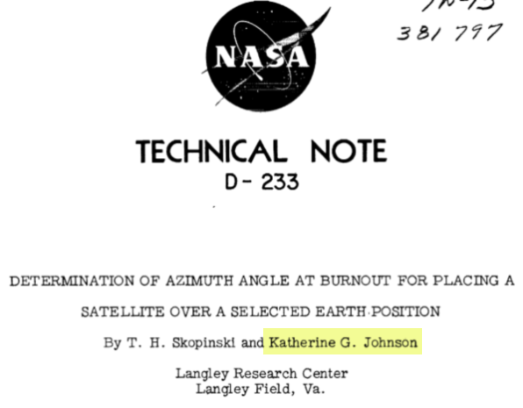
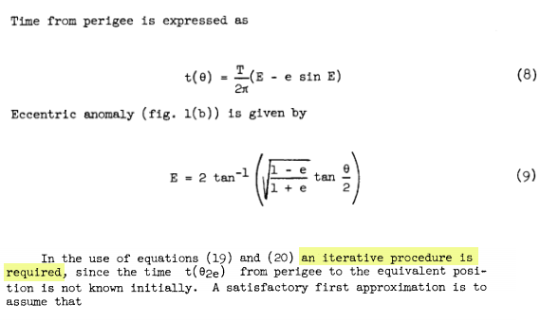
Hidden Figures, Fox 2000 Pictures, 2016
Euler’s Method

Slide 4
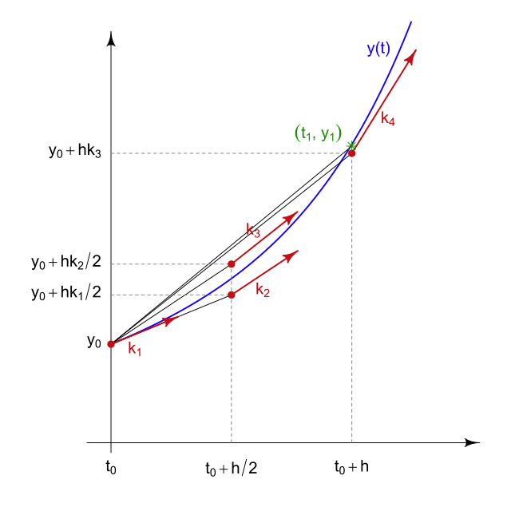

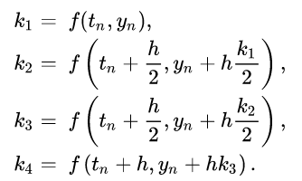
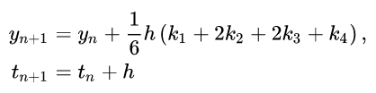
Runge-Kutta Methods

Slide 5

Solve Differential Equations with SciPy
https://scipy.org

Slide 6
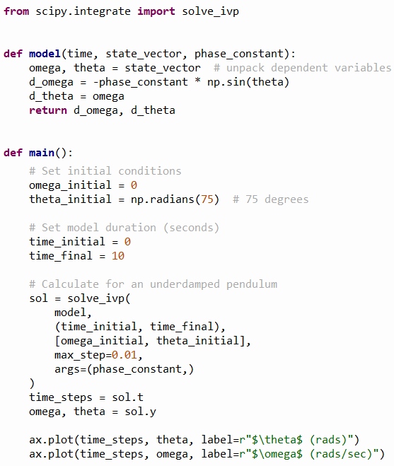
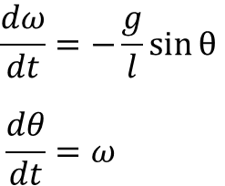
Open scipy_pendulum.py
①
②
③
④
⑤

Slide 7
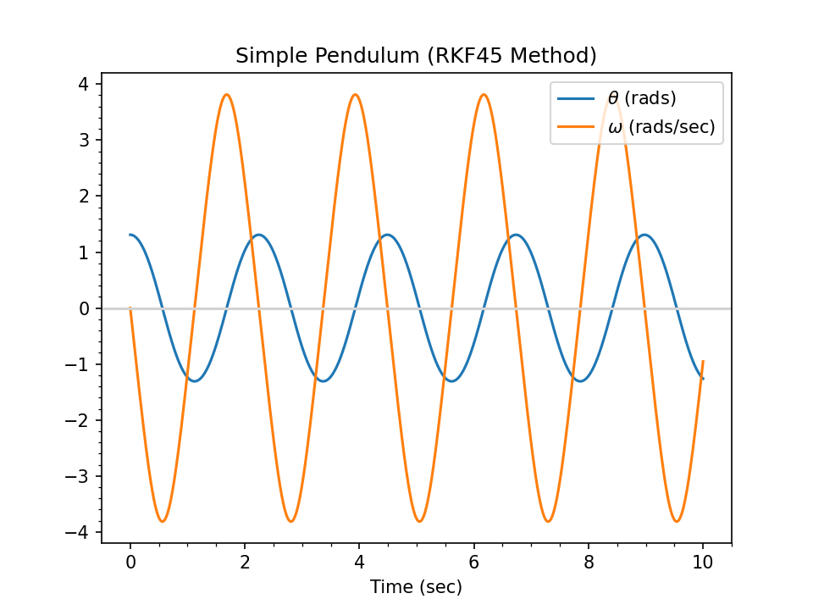
Run scipy_pendulum.py
①
②
$$θ_{0}={75}^{°}$$
What is the physics story at these circled times?

Slide 8
Damped Harmonic Oscillator
In real oscillators, friction (or damping) slows the motion of the system. Due to frictional force, the velocity decreases in proportion to the acting frictional force
In contrast to a simple undriven harmonic oscillator (where the only force acting on the mass is the restoring force) in a damped harmonic oscillator there is in addition a frictional force which is always acts in the direction opposing the motion
We always strive to develop mathematical models that are as realistic as possible – friction is hard to avoid in the real world and therefore should not be ignored in a simulation

Slide 9
Damped Harmonic Oscillator
$$\frac{d^{2}θ}{dt^{2}}=−\frac{g}{l}\sin{θ}$$
We can introduce a new resistive force term into the equation of motion for a pendulum
$$\frac{d^{2}θ}{dt^{2}}=−q\frac{dθ}{dt}−\frac{g}{l}\sin{θ}$$
$q$= damping_constant
$$\frac{dω}{dt}=−qω−\frac{g}{l}\sin{θ}$$
$$\frac{dθ}{dt}=ω$$

Slide 10
Damped Harmonic Oscillator
Underdamped – The system swings back and forth (oscillates) over its equilibrium point, but ultimately comes to rest
Example: $q=1$
Overdamped – The system never oscillates, but it takes a while for it to return to its equilibrium point
$$\text{Example}\text{:} q=\frac{{\left(phase_constant\right)}^{2}}{2}$$
Critically damped – The system never oscillates and returns to its equilibrium point in the least amount of time
$$q=\frac{{\left(phase_constant\right)}^{2}}{4}$$
Note: There is only one value for $q$ where the system is critically damped

Slide 11
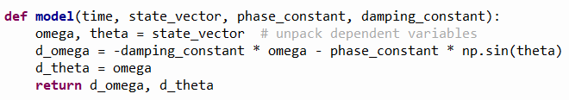

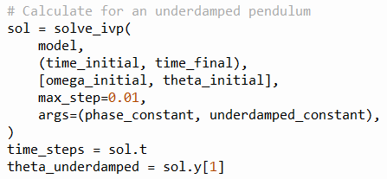
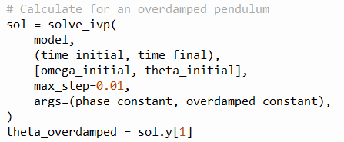
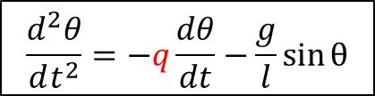
Open damped_pendulum.py
①
②
③
$$\frac{d^{2}θ}{dt^{2}}=−q\frac{dθ}{dt}−\frac{g}{l}\sin{θ}$$
④
⑤
⑥
⑨
⑦
⑩
⑧

Slide 12
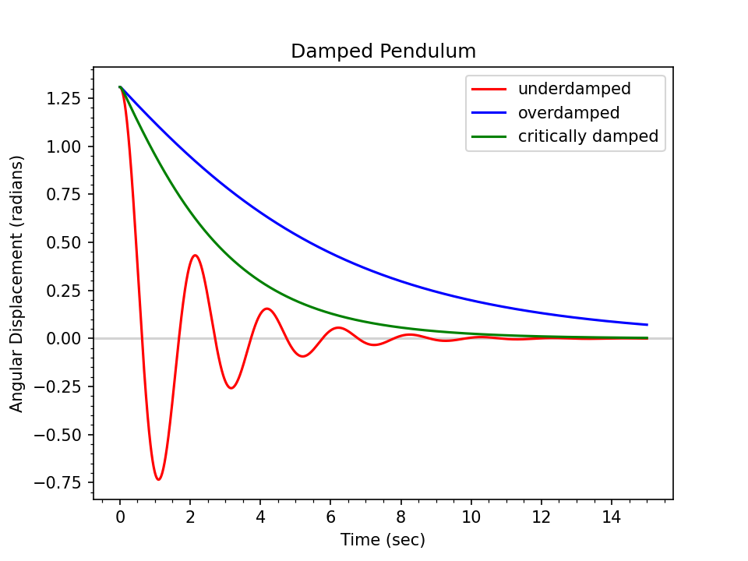
Run damped_pendulum.py
In what applications would you want a system to be critically damped?

Slide 13
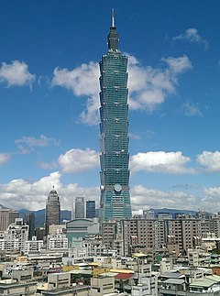
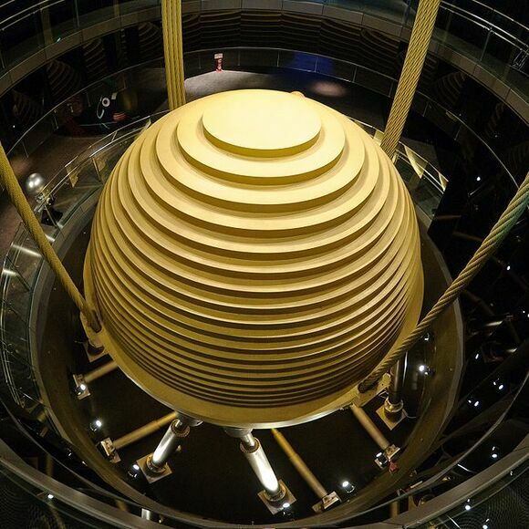
Tuned Mass Dampers
Taipei 101 – Taiwan
The Worlds Tallest Building (2004-2009)
730 Tons

Slide 14
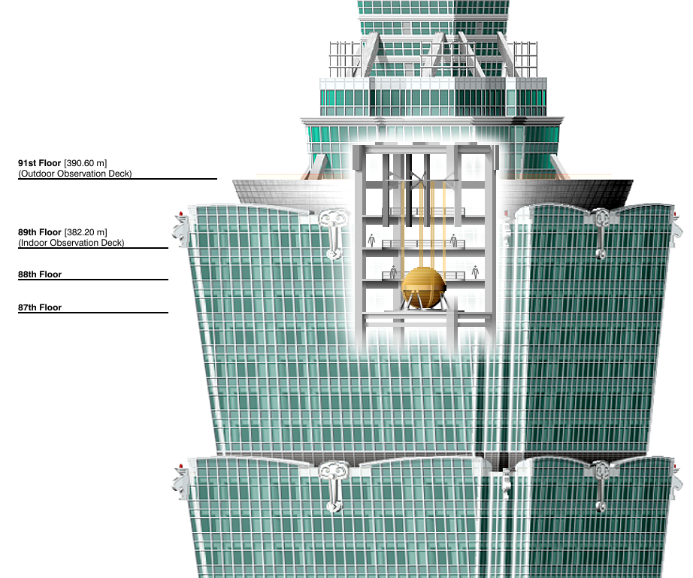
Tuned Mass Dampers
365 Minivans

